Slide 1
Salary Estimation using Machine Learning
Presented by
Tarun Ashwini
19671A1207

Slide 2
Short Overview on Machine Learning
Machine Learning
Machine learning (ML) is a type of artificial intelligence (AI) that allows software applications to become more accurate at predicting outcomes without being explicitly programmed to do so. Machine learning algorithms use historical data as input to predict new output values.
Types of problems can be solved using ML
1. Regression:
A machine learning technique whose aim is to predict a trending a hyperplane for a dataset which has a continues labelled output/dependent feature.
2. Classification:
A machine learning technique whose aim is to predict a discrete class label output/dependent feature.
3. Clustering:
A machine Learning technique whose aim is to group the data points having similar features and not having any proper dependent feature.

Slide 3
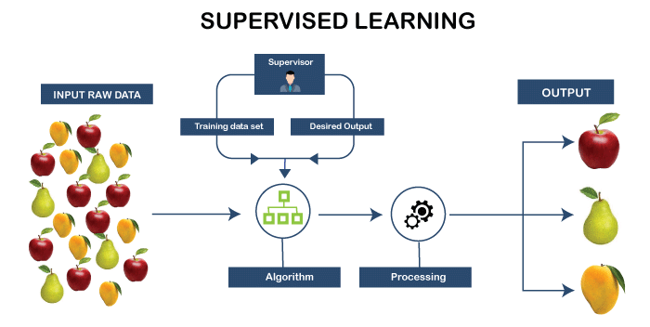
Types of Learning in ML

Slide 4
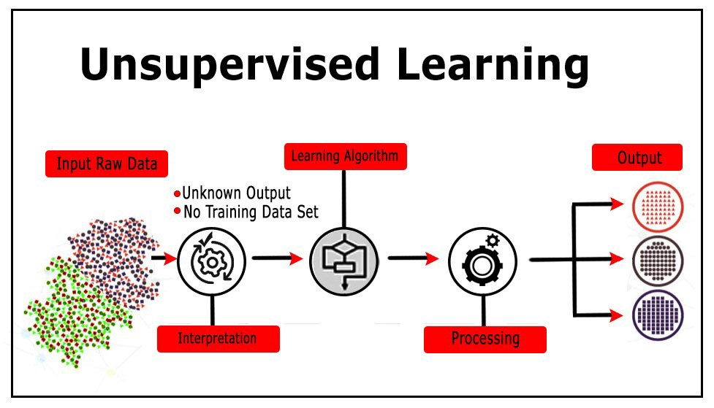
Types of Learning in ML

Slide 5
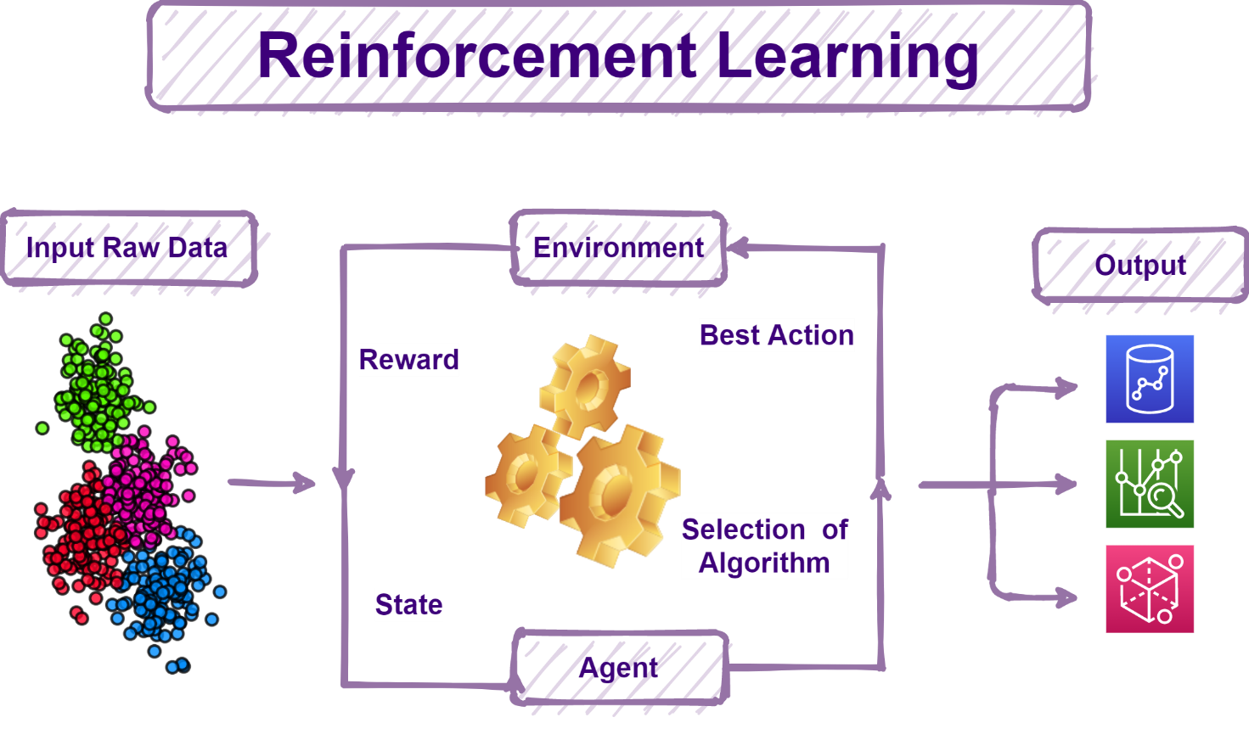

Slide 6
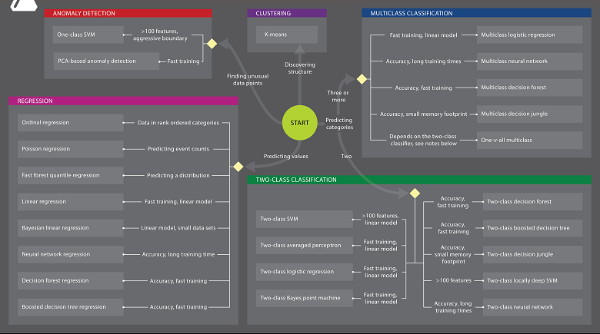
Algorithms Cheat Sheet on ML

Slide 7
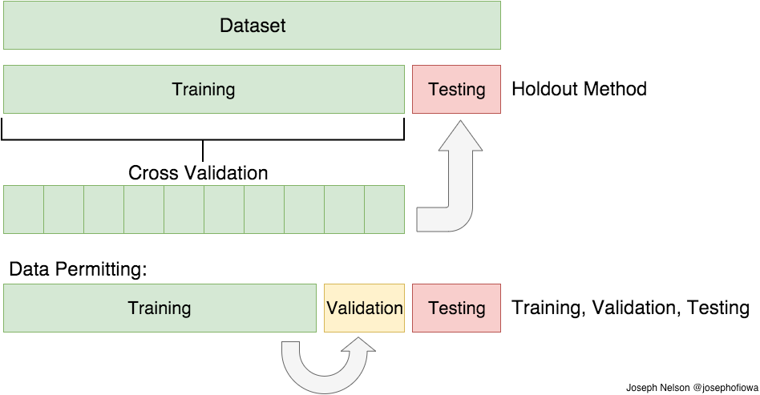
Splitting of the dataset

Slide 8
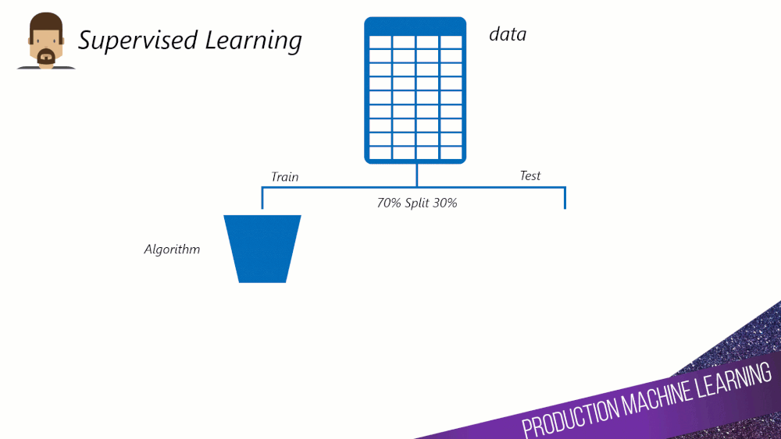
A small gif on Splitting Data

Slide 9
Abstract of project
This project is a which helps common students to estimate their salary by consider some data such as their gender, 10th grade score, 12th grade score, b-tech score and so on. The tool also helps student to estimate there salary so that they can negotiate the salary during their interview and get hired with a good salary package and develop their career.
This tool used Linear, SVR, Decision Tree, Random Forest algorithm to predict the best salary. But among all the algorithms Random Forest algorithm is the one best algorithm which predicts the salary with more accuracy. And it also uses a Graphical User Interface (GUI) which was made by using streamlit that maintains the interaction with the real time users.

Slide 10
Problem we are solving
The main problem we are trying to solve through this project is build a tool that estimates the salary of student when they give some inputs like their 10th, 12th grade score and so on. The predicted value helps student to negotiate about their salaries during the interview times. And also with this predicted value they can analyse their position in this competitive world and raise their skills.

Slide 11
Hardware Requirements
Modern Operating System.
Windows 7 or 10.
Mac OS X 10.11 or higher, 64-bit.
Linux: RHEL 6/7, 64-bit (almost all libraries also work in Ubuntu).
x86 64-bit CPU (Intel / AMD architecture).
4 GB RAM.
5 GB free disk space.

Slide 12
Module Requirements
Sklearn module.
Pandas module.
NumPy module.
Matplotlib module.
Seaborn module.

Slide 13
List of algorithms used
As this is regression based problem we used 4 most popular algorithms, they are:
1. Linear Regression.
2. Support Vector Regression.
3. Decision Tree Regression.
4. Random Forest Regression.

Slide 14

Linear Regression

Slide 15
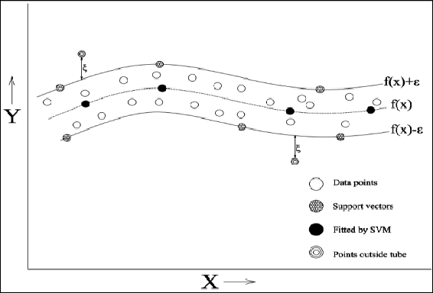
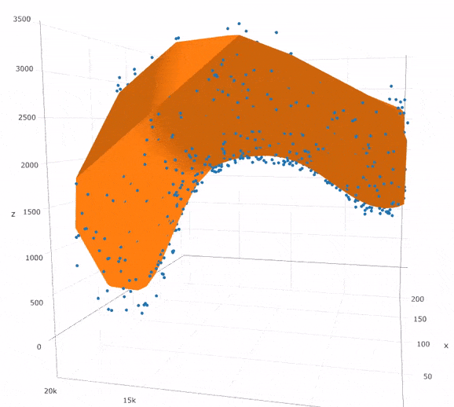
Support Vector Regression

Slide 16
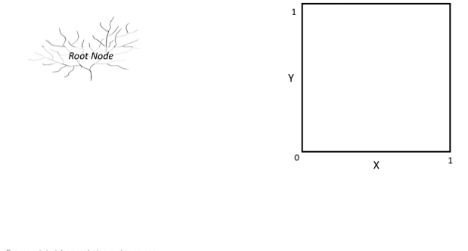
Decision Tree Regression

Slide 17
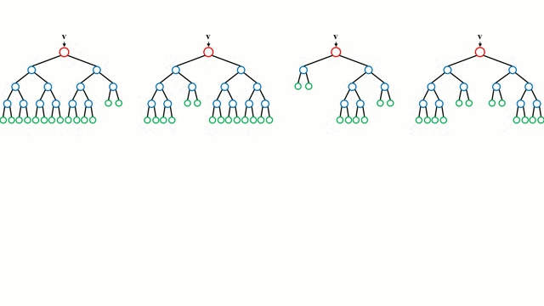
Random Forest Regression

Slide 18
Graphical User Interface
Graphical User Interface:
A graphical user interface (GUI) is a type of user interface through which users interact with electronic devices via visual indicator representations.
We used Streamlit plugin to build Graphical User Interface (GUI) of our project. This helps us to makes users to interact with model and tool.
Streamlit
Streamlit is an open-source python library for creating and sharing web apps for data science and machine learning projects. The library can help you create and deploy your data science solution in a few minutes with a few lines of code.

Slide 19
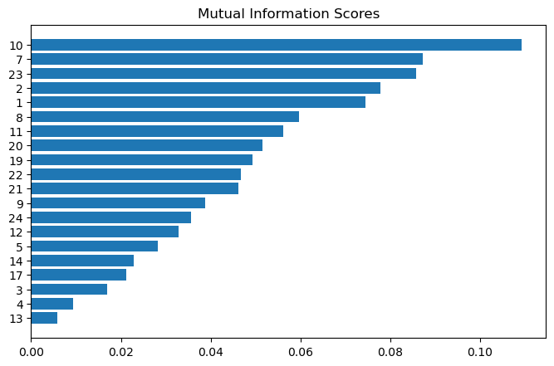
Feature Extraction Histograms
Mutual Information:
Mutual information is one of many quantities that measures how much one random variables tells us about another. [Quant, GraduationYear, experince, 12percentage, 10percentage ].

Slide 20
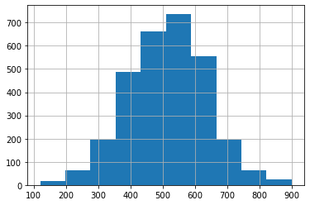
Histogram of Quant feature

Slide 21
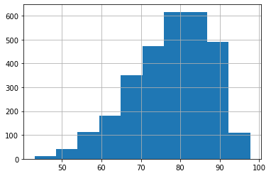
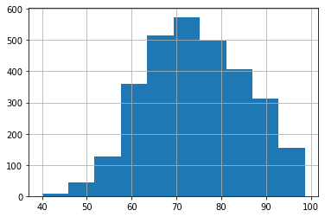
Histograms
10th grade scores
12th grade scores

Slide 22
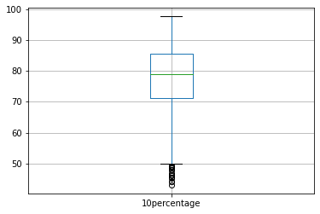
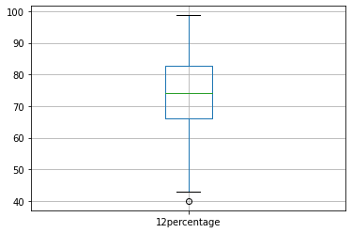
Histograms
10th grade scores
12th grade scores

Slide 23
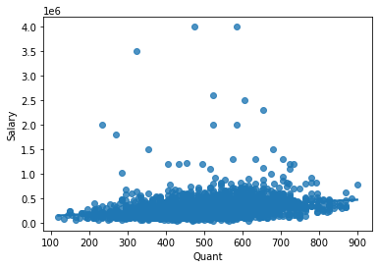
Scatterplot (Quant vs Salary)

Slide 24
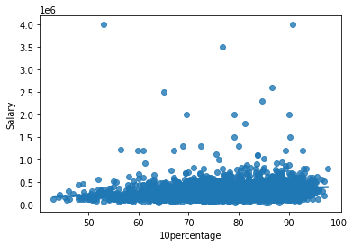
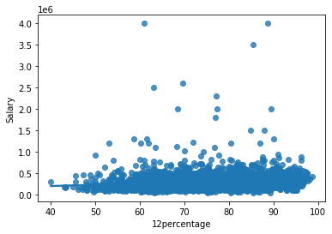
Scatterplots
10th grade scores
12th grade scores

Slide 25
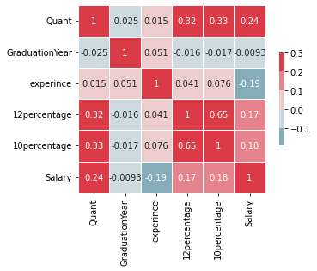
Heatmap of correlation
Correlations:
Correlation is a statistical term describing the degree to which two variables move in coordination with one another.

Slide 26
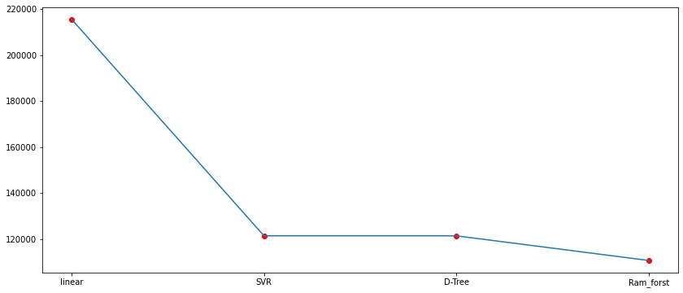
Comparison of algorithms
To build the tool we used Linear, SVR, Decision Tree and Random Forest in Regression mode.

Slide 27
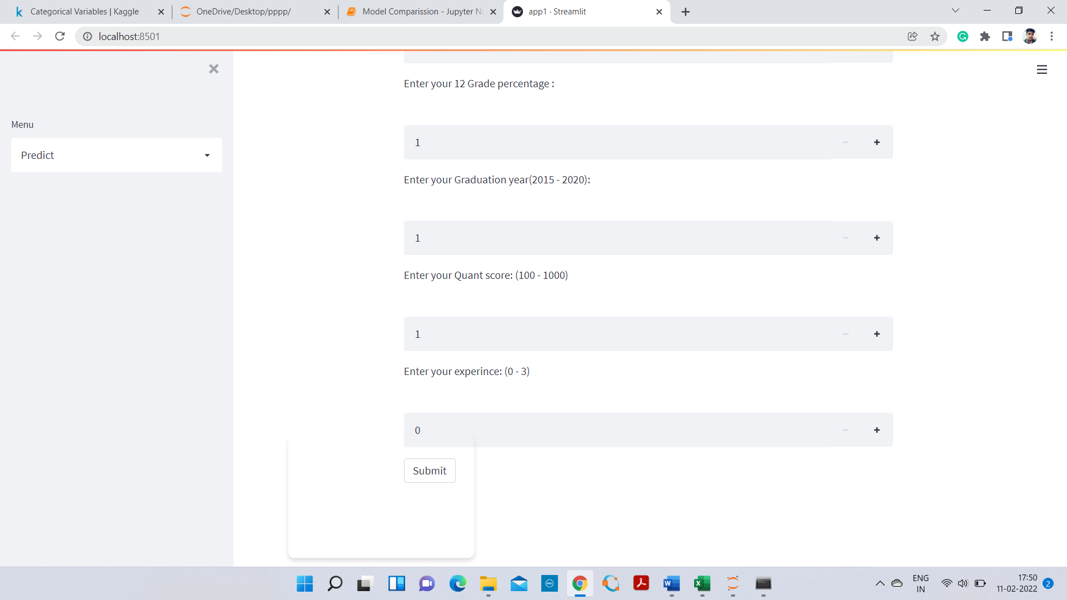
Graphical User Interface

Slide 28

Thank you

